Slide 1
COLLEGE MANAGEMENT SYSTEM​
Project Member :
Ms. Neha
Mr. Gopalsingh ​
Mr. Suresh​​
Mr. Shashank​​
Mr. Pradeep​​
Mr. Harish Kumar ​
Guided By :
Prof. Indrakka Mali​​

Slide 2
Contents :
Introduction
ER Diagram
Working of Back-End
Annotations
APIs
Software Requirement
Features Of System
Conclusion

Slide 3
Introduction :
The college management system helps Educational Institutions especially colleges in various ways, such as storing data, maintain student profiles, analyzing administrative and academic data, improving communication, and engaging students.
College Management System is an end-to-end solution for colleges to improve operational efficiency & institutional outcomes by automating Student-Faculty lifecycle & campus administration.
The COLLEGE MANAGEMENT SYSTEM can be used to store student information like attendance, fees, and student result etc.

Slide 4
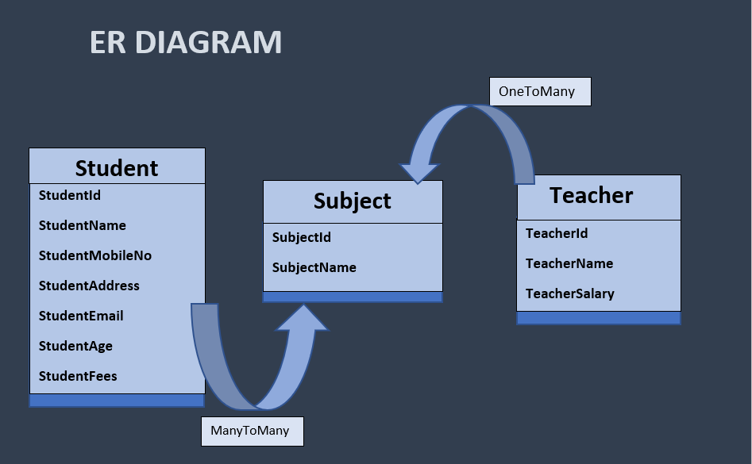

Slide 5
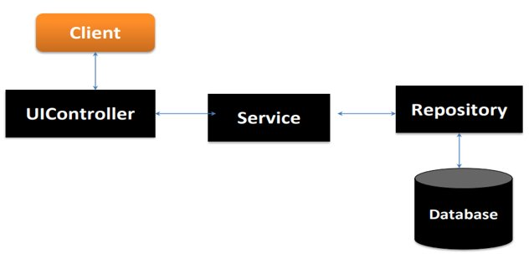
Working Of Back-End :
There are mainly three stages

Slide 6
Work Flow :
Client send a request to server for different options like inserting ,fetching ,update and delete a data.
When client hit on request .Request goes to the Controller Class and use respective URL to take data.
Then control of URL goes to the service Class And Conditions get Executed.
For returning response to client use same sequence. Service To Controller Class.
Here Repository class is used to interact with database using Hibernate Technology.

Slide 7
Annotations (@) :
Annotations are used to provide supplemental information
about a program.
Annotations start with ‘@’.
@Id : This id annotation is used to declare attribute as primary key.
@GeneratedValue : Used to generate value automatically when user insert new record in table.
3. @Not Empty : used for validation.

Slide 8
4. @Email : used to compare email format ​.​
5. @size : Used in collection. ​
6. @NotNull : This gives mandatory filed to enter data.​
8. @ManyToOne : To create the many-to-one relationship between the Student and subject class.​
9. @JoinColumn : helps us specify the column we'll use for joining.
10. @JsonIgnore : Is used to ignore the logical property used in serialization and deserialization.​
11. @Entity : is used is used to mark this class as an Entity bean.​
​

Slide 9
12. OneToMany : is used to create the one-to-many relationship between the subject id and Student entities​.
13. Cascadetype.All : ensure that all persistence events such as persist, refresh, merge and remove that occur on the parent, will be passed to the child.​
14. @override : Informs the compiler that the element is meant to override an element declared in a superclass.​
15. @RestController : This annotation is used at the class level and allows the class to handle the requests made by the client.​
16. @Autowired : Enables you to inject the object dependency implicitly.​

Slide 10
17. @ControllerAdvice : Allows to handle exceptions across the whole application in one global handling component.​
18. @ResponseStatus : To mark a method or an exception class with a status code and reason that should be returned.​
19. @ExceptionaHandler : Used to handle the specific exceptions and sending the custom responses to the client.​
20. @Service : It is used to mark the class as a service provider
21. @Notnull : It is used to makes entity as not null.
22. @Max : Max is used to validation to show the max value.

Slide 11
23. @Repository : Repository is used in repository class.
24. @Query : Its declares finder queries directly on repository methods.

Slide 12
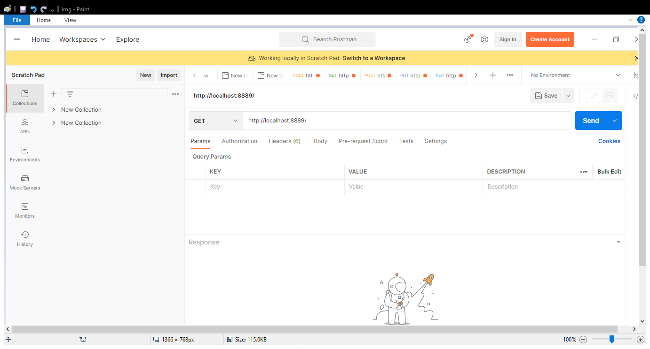
Application Programming Interface(APIs);
APIS Under Director To Do :
“director/all/” : Direct can access all student details using this URL.

Slide 13
Student URL:
1. “post/student” : To add the student details in table.
2. “get/student” : we can get all student record which is in student table.
3. “delete/student/stuid” :​ It is used to delete particular record in table to use studentid.
4. “put/student/stuid” : It is to update particular student by studentid.
5. “get/student/stuid” : This url is to get a particular student by using studentid.
6. “get/student/name” : Its used to get particular student by its name.

Slide 14
7. “/get/studenttotalfees” : This url for to calculate the all student fees.
Subject URL :
“post/subject” : It used for for to add subjects in table.
“get/subject” : This url for getting all subjects record in the table.
“delete/subject/subid” : Its for deleted particular record in the table.
“put/subject/subid” : Its for update a particular subject in existing table.

Slide 15
5. “put/subject/subid/student/stuid” : It is assign to particular student to particular subject bases on their the relation.
6. “put/subject/subid/teacher/tid” : This url for assign the teacher to subject.
7. “get/subject/subid” : It is for get particular subject by using subjectid.
8. “get/subject/name” : It is for the get particular subject by its name.

Slide 16
Teacher URL :
“post/teacher” : To add the teacher records in table.
2. “get/teacher” : It is for getting all teacher record in tables.
3. “delete/teacher/tid” : To delete a particular teacher record by using teacherid.
4. “put/teacher/tid” : To update particular record by using particular teacherid.
5. “get/teacher/tid” : get the particular teacher record.

Slide 17
6. “get/teacher” : To get a particular teacher record by its name.
7. “get/teachertotalsalary” : To calculate the all teacher salary.
“ get/profitandloss” : It is in profit and loss controller class to calculate profit and loss of college.

Slide 18
Software & hardware used :
Software Requirements :
Operating System : Windows 7, 8, 10, 11
Language : Java
IDE : Spring Tool Suite
Client : Postman
Backend : MySQL
Hardware Requirements :
CPU : Intel Pentium V processor
RAM : 4 GB or above
Hard Disk : 64 GB hard disk space or minimum

Slide 19
Advantages :
Better and improved admission rate.
Better teacher performance.
Drastic reduction in manual tasks.
Elimination of paper based tasks.
Improved fee management.

Slide 20
Makes the institute smart and ready for the future.​​
Improved institute reputation​​.
better resource utilization​​.
Duplication of the student and teacher data is avoided.​​

Slide 21
Conclusion :
The project entitled as College Management System is the system that deals with the issues related to a particular institution.
This project is successfully implemented with all the features mentioned in system requirements specification.
Awareness and right information about any college is essential for both the development of student as well as faculty.
So this serves the right purpose in achieving the desired requirements of both the communities.

Slide 22


